Slide 1
Black Box Testing State Transition Testing

Slide 2
Finite State Machine (FSM)
An FSM is a behavioral model whose outcome depends upon both previous and current inputs.
有限状态机（FSM）是一种行为模型，其结果取决于先前和当前的输入。
FSM models can be prepared for software structure or software behavior.
FSM模型可以用于软件结构或软件行为的准备。
It can be used as a tool for functional testing.
它可以作为功能测试的工具。
Many testers prefer to use FSM model as a guide to design functional tests.
许多测试人员更喜欢使用FSM模型作为设计功能测试的指南。
A finite state system is often shown as a state diagram
有限状态系统通常以状态图显示。

Slide 3
State Transition Testing
State transition testing is used where some aspect of the system can be described in what is called a 'finite state machine'.
状态转换测试用于系统的某些方面可以用所谓的“有限状态机”来描述的情况
This simply means that the system can be in a (finite) number of different states, and the transitions from one state to another are determined by the rules of the 'machine'.
这简单意味着系统可以处于有限数量的不同状态，并且从一个状态到另一个状态的转换由“机器”的规则决定。

Slide 4
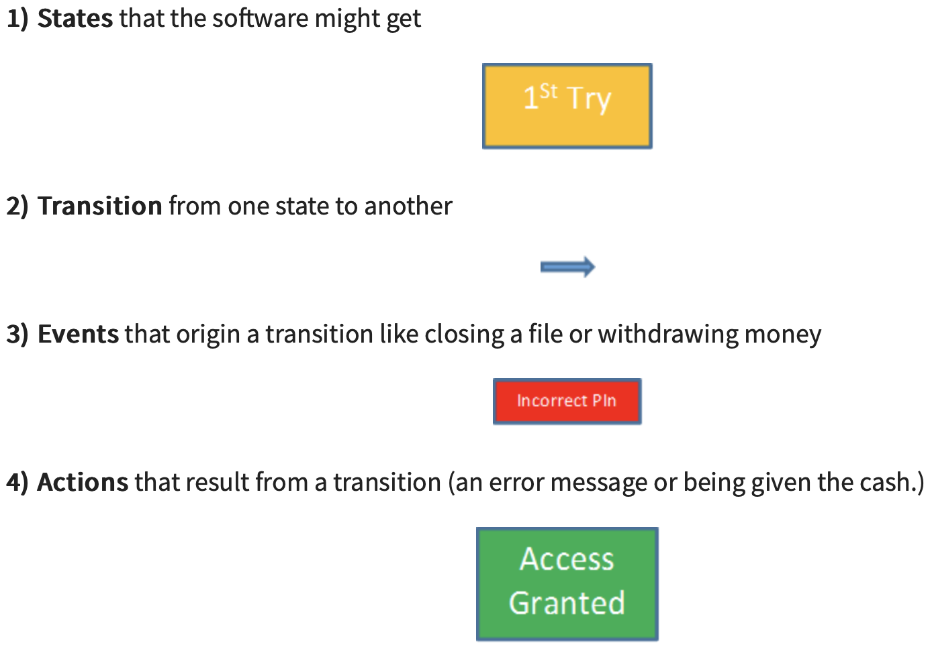
State Transition Testing
A state transition model has four basic parts:
the states that the software may occupy (open/closed or funded/insufficient funds);
the transitions from one state to another (not all transitions are allowed);
the events that cause a transition (closing a file or withdrawing money);
the actions that result from a transition (an error message or being given your cash).

Slide 5
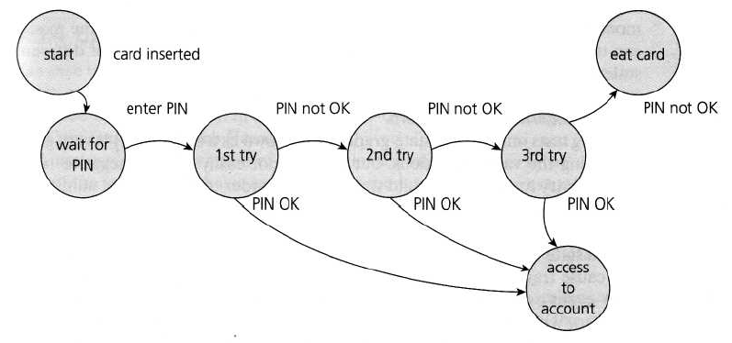
Example 1: State Transition Testing
States are represented by nodes. Now with the help of nodes and transition links between the nodes, a state transition diagram or state graph is prepared.
State Diagram for PIN Entry

Slide 6
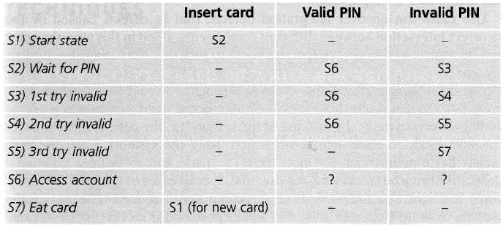
State Transition Testing
The following conventions are used for the state table :
Each row of the table corresponds to a state.
Each column corresponds to an input condition.
The box at the intersection of a row and a column specifies the next state (transition) and the output, if any.
State table for the PIN example

Slide 7
Example 2: Class Activity
Take the scenario where you want to login to your online banking site. First, you have to load the online banking page, then go to the login page. Then you will enter the credentials and attempt to log in. If the credentials are correct you will be granted access. If they are incorrect you will be given another attempt. After 3 unsuccessful attempts, the Account will be blocked for safety reasons.

Slide 8
Solution
Let’s first identify all the states of this system.
States
Start – Load the Online Banking page
Load Login page
1st Attempt
2nd Attempt
3rd Attempt
Events
Click Login
Enter Credentials
Correct Credentials
Incorrect Credentials
Actions
Access Granted
Account Blocked
Transitions
From the Home page to the Login page
1st login Attempt
1st login Attempt -> success
1st login Attempt -> unsuccessful -> 2nd login attempt
2nd login Attempt -> success
2nd login Attempt -> unsuccessful -> 3rd login attempt
3rd login Attempt -> success
3rd login Attempt -> unsuccessful

Slide 9
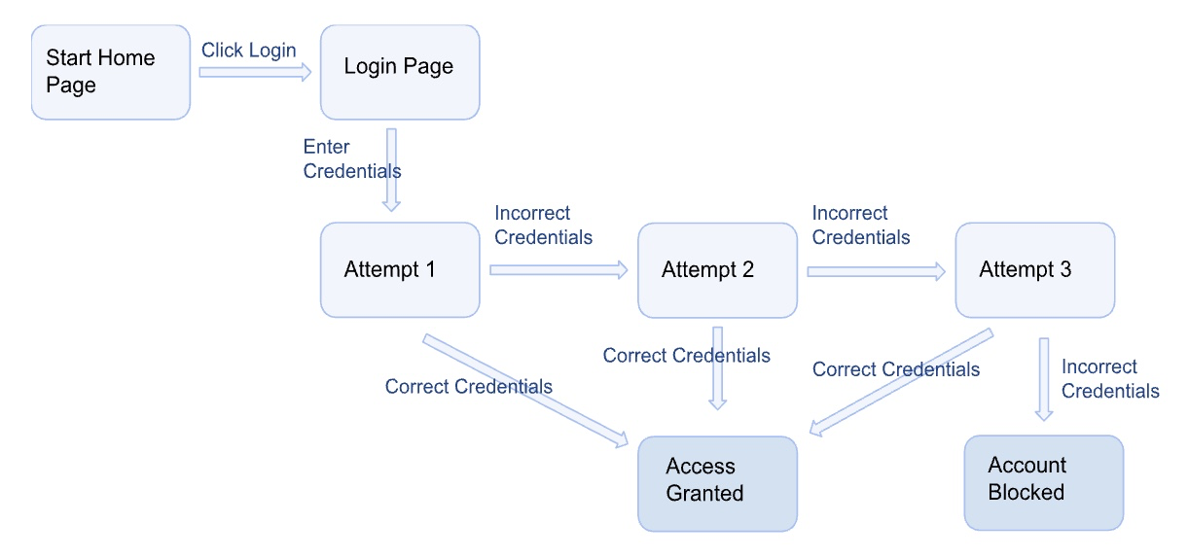
State Transition Diagram

Slide 10
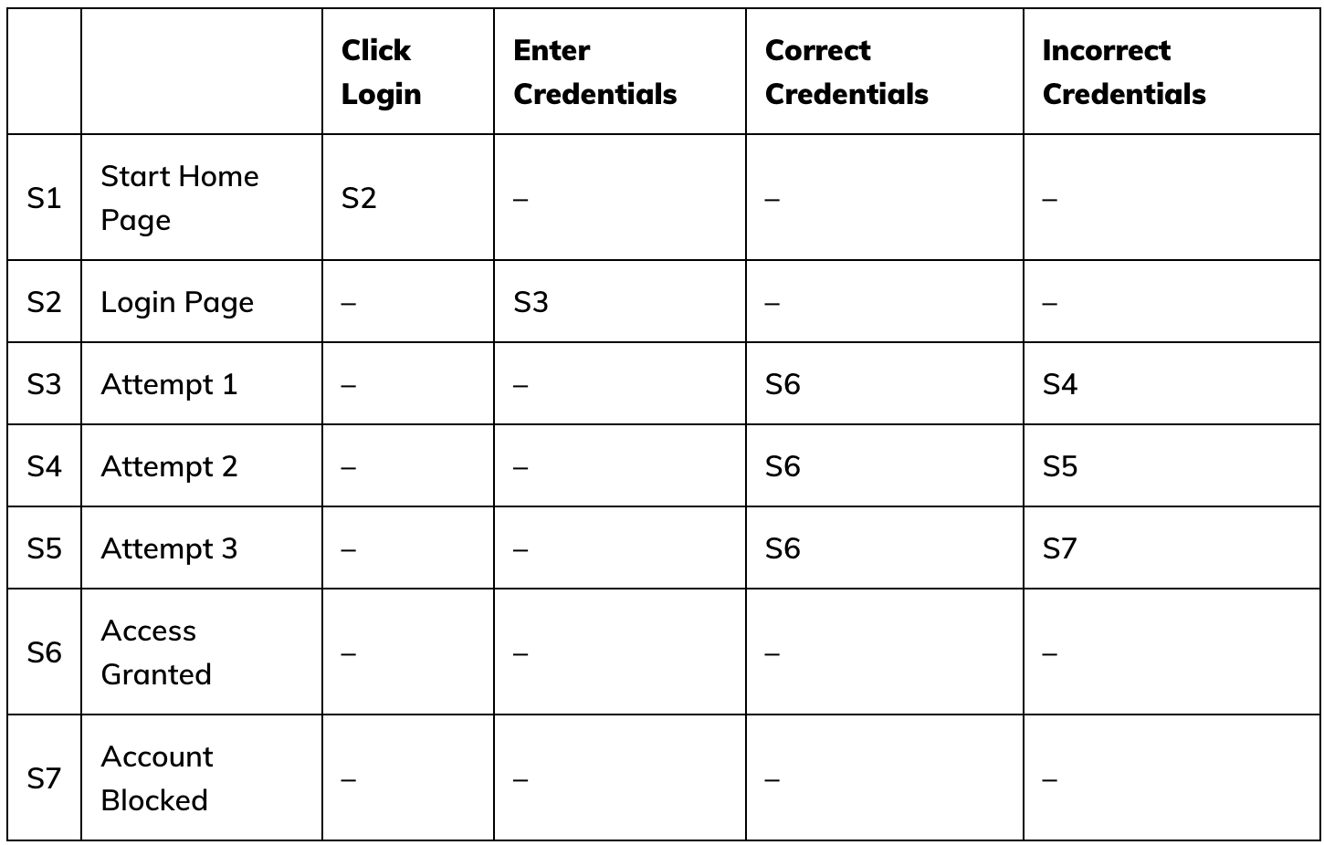
State Transition Table

Slide 11
Example 3: Homework
Consider a system having an FSM for a stack having the following states and transitions:
States
Initial: Before creation
Empty: Number of elements = 0
Holding: Number of elements > 0, but less than the maximum capacity
Full: Number elements = maximum
Final: After destruction
Transitions
Initial to Empty: Create
Empty to Holding, Empty to Full, Holding to Holding, Holding to Full: Add
Empty to Final, Full to Final, Holding to Final: Destroy
Holding to Empty, Full to Holding, Full to Empty: Delete
Design test cases for this FSM using state table-based testing.

